Slide 1
Title Layout
Subtitle

Slide 3
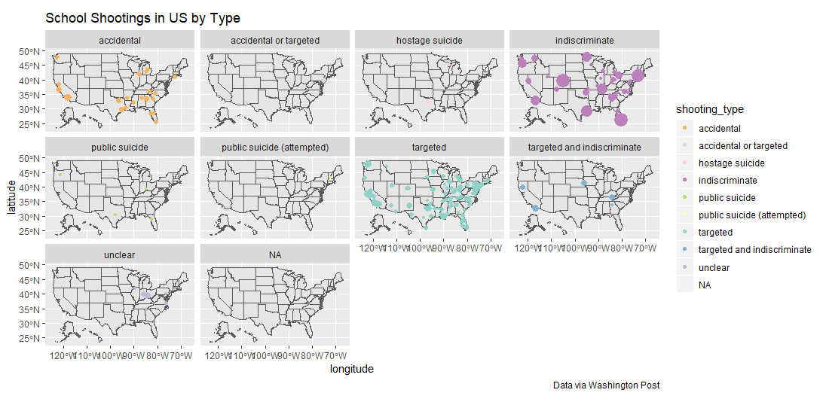

Slide 4
Title and content layout with list
Add your first bullet point here
Add your second bullet point here
Add your third bullet point here

Slide 5
Title and content layout with chart

Slide 6
Two content layout with table
First bullet point here
Second bullet point here
Third bullet point here
Class | Group 1 | Group 2
Class 1 | 82 | 95
Class 2 | 76 | 88
Class 3 | 84 | 90

Slide 7
Title and content layout with SmartArt
Step 1 Title
Task description
Step 2 Title
Task description
Step 3 Title
Task description

Slide 8
Add a Slide Title - 1

Slide 9
Add a Slide Title - 2

Slide 10
Add a Slide Title - 3

Slide 11
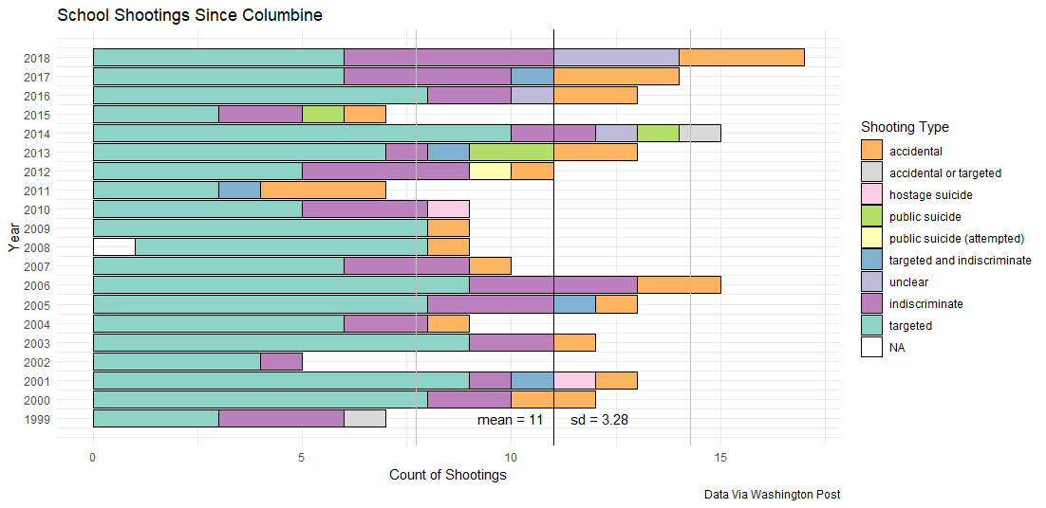

Slide 12
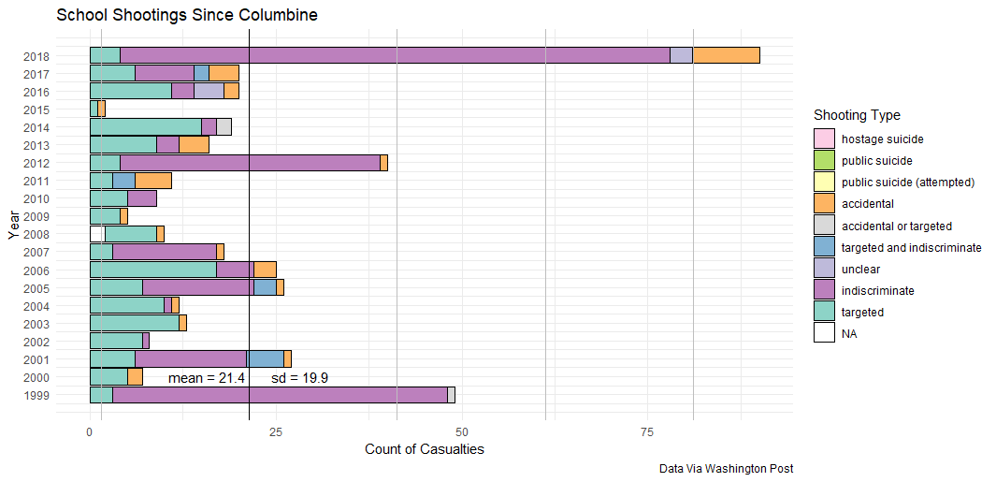

Slide 13
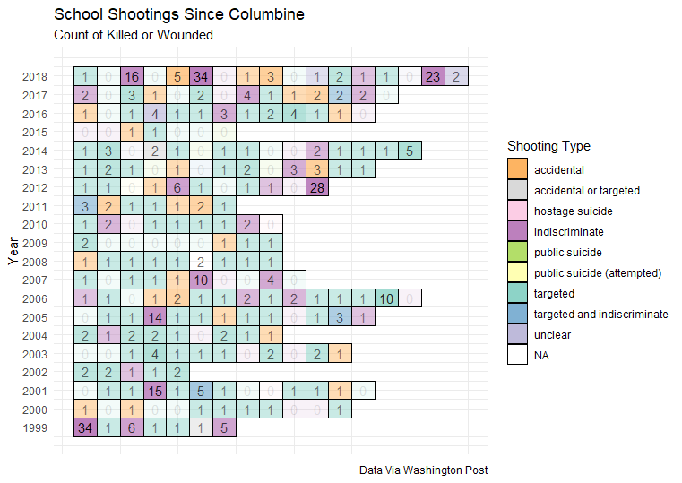
The incidents that make the news…
Are perhaps rarer than we think.
However, no matter what, 2018 is on track to be an outlier year

Slide 14
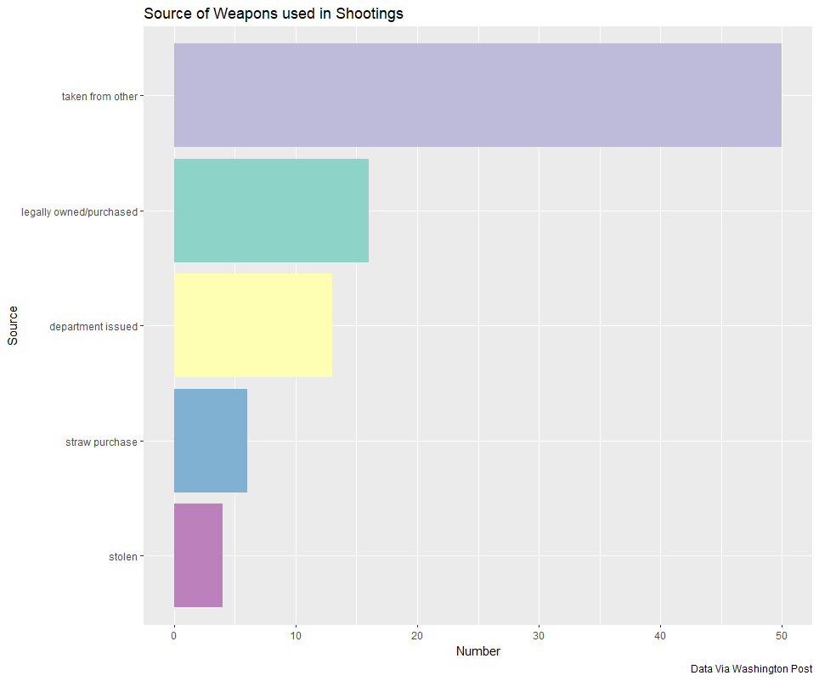
What is the source of the weapons?
The third most common source of weapons used in school shootings is the police department that issued the weapon to the officer.
Outliers: In one case, a student purchased parts for a gun legally, then assembled the weapon at home.

Slide 15
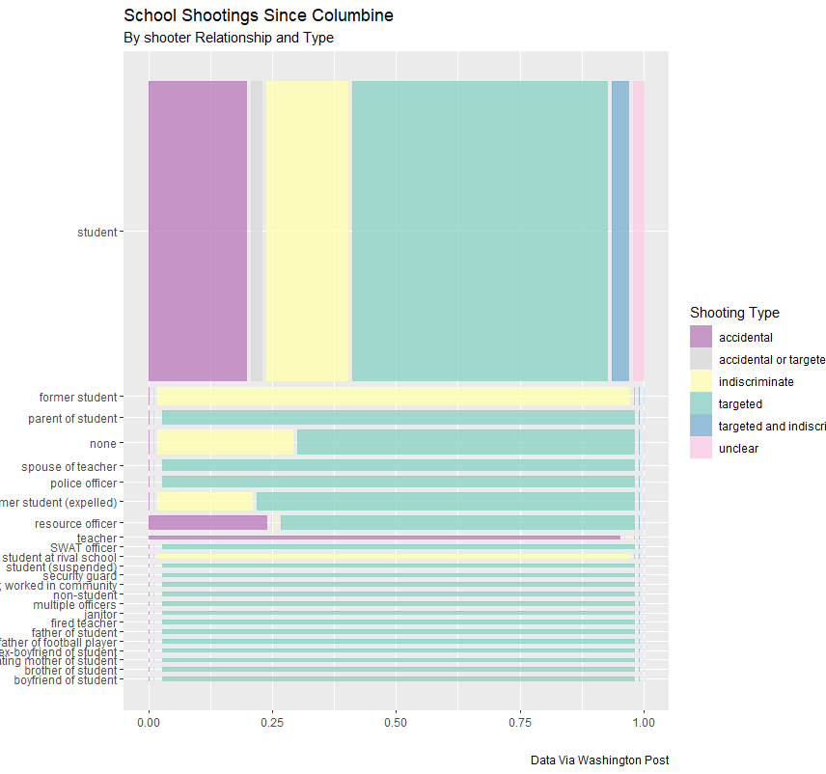
What can we glean about causes from Relationship Types?
And what policy implications do these have?

Slide 17
D. Kahle and H. Wickham. ggmap: Spatial Visualization with ggplot2. The R Journal, 5(1), 144-161. URL http://journal.r-project.org/archive/2013-1/kahle-wickham.pdf

